Slide 1
Introduction to Transaction Processing Concepts and Theory

Slide 2
Outline
1. Introduction to Transaction Processing Concepts
Transaction System
Transaction Operations
2. ACID Properties
Transaction States
Types of Failures

Slide 3
Introduction
A database transaction symbolizes a unit of work performed within a database management system (or similar system) against a database, and treated in a coherent and reliable way independent of other transactions. A transaction generally represents any change in a database.

Slide 4
Introduction to Transaction
In a database management system, a transaction is a single unit of logic or work, sometimes made up of multiple operations. Any logical calculation done in a consistent mode in a database is known as a transaction.

Slide 5
Introduction to Transaction Processing
Transaction: An executing program (process) that includes one or more database access operations
Read operations (database retrieval, such as SQL SELECT)
Write operations (modify database, such as SQL INSERT, UPDATE, DELETE)
Transaction: A logical unit of database processing
Example: Bank balance transfer of $100 dollars from a checking account to a saving account in a BANK database
Note: Each execution of a program is a distinct transaction with different parameters
Bank transfer program parameters: savings account number, checking account number, transfer amount

Slide 6
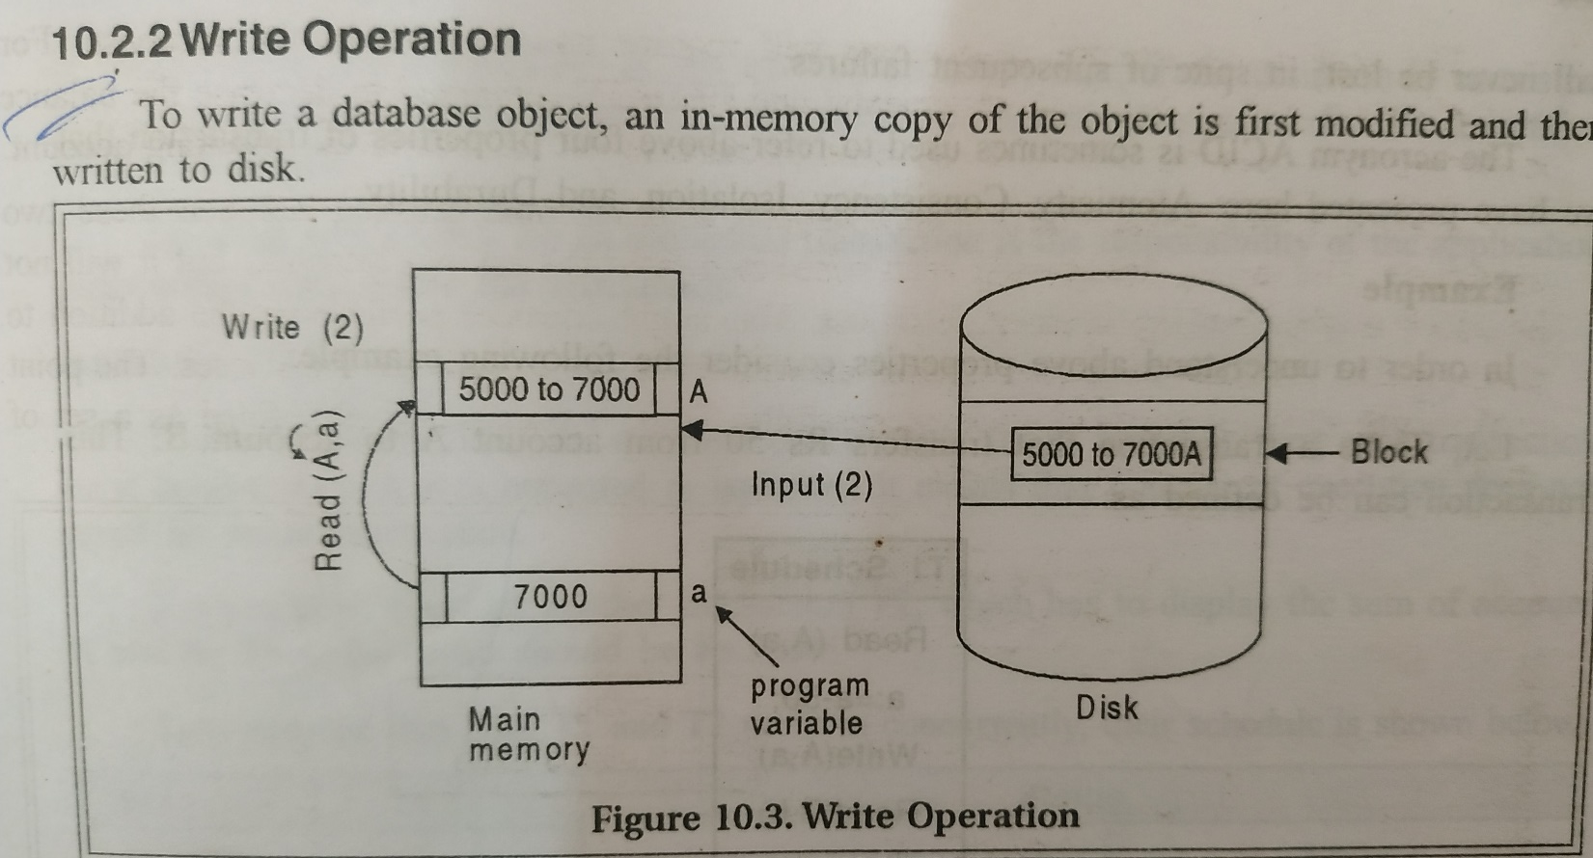
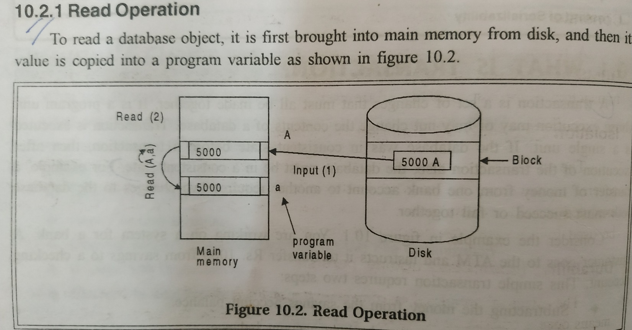

Slide 7
Introduction to Transaction Processing (cont.)
A transaction can be defined as an action or series of actions that is carried out by a single user or application program to perform operation for accessing the contents of the database.
Transaction boundaries: Begin and End transaction.
Note: An application program may contain several transactions separated by Begin and End transaction boundaries

Slide 8
X=8000
Initial State
Consistent State
Transaction
Read-→ modify→write
Salary
Database
X=X-1000
Modified database
X=7000
Final State
Consistent State

Slide 9
Introduction to Transaction Processing (cont.)
Transaction Processing Systems: Large multi-user database systems supporting thousands of concurrent transactions (user processes) per minute
Two Modes of Concurrency
Interleaved processing: concurrent execution of processes is interleaved in a single CPU
Parallel processing: processes are concurrently executed in multiple CPUs (Figure 21.1)
Basic transaction processing theory assumes interleaved concurrency

Slide 10
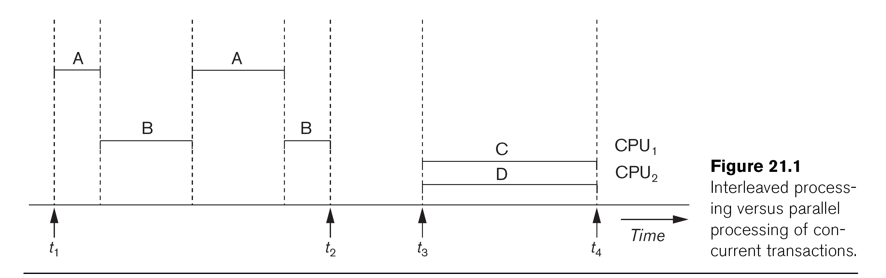

Slide 11
Introduction to Transaction Processing (cont.)
For transaction processing purposes, a simple database model is used:
A database - collection of named data items
Granularity (size) of a data item - a field (data item value), a record, or a whole disk block
TP concepts are independent of granularity
Basic operations on an item X:
read_item(X): Reads a database item named X into a program variable. To simplify our notation, we assume that the program variable is also named X.
write_item(X): Writes the value of program variable X into the database item named X.

Slide 12
Transaction Processing Operations
READ AND WRITE OPERATIONS:
Basic unit of data transfer from the disk to the computer main memory is one disk block (or page). A data item X (what is read or written) will usually be the field of some record in the database, although it may be a larger unit such as a whole record or even a whole block.
read_item(X) command includes the following steps:
Find the address of the disk block that contains item X.
Copy that disk block into a buffer in main memory (if that disk block is not already in some main memory buffer).
Copy item X from the buffer to the program variable named X.

Slide 13
Transaction Processing Operations(cont.)
READ AND WRITE OPERATIONS (cont.):
write_item(X) command includes the following steps:
Find the address of the disk block that contains item X.
Copy that disk block into a buffer in main memory (if it is not already in some main memory buffer).
Copy item X from the program variable named X into its correct location in the buffer.
Store the updated block from the buffer back to disk (either immediately or at some later point in time).

Slide 14
Transaction Notation
Figure 21.2 (next slide) shows two examples of transactions
Notation focuses on the read and write operations
Can also write in shorthand notation:
T1: b1; r1(X); w1(X); r1(Y); w1(Y); e1;
T2: b2; r2(Y); w2(Y); e2;
bi and ei specify transaction boundaries (begin and end)
i specifies a unique transaction identifier (TId)

Slide 16
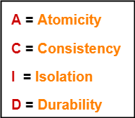
Desirable Properties of Transactions
It is important to ensure that the database remains consistent before and after the transaction.
To ensure the consistency of database, certain properties are followed by all the transactions occurring in the system.
These properties are called as ACID Properties of a transaction.

Slide 17
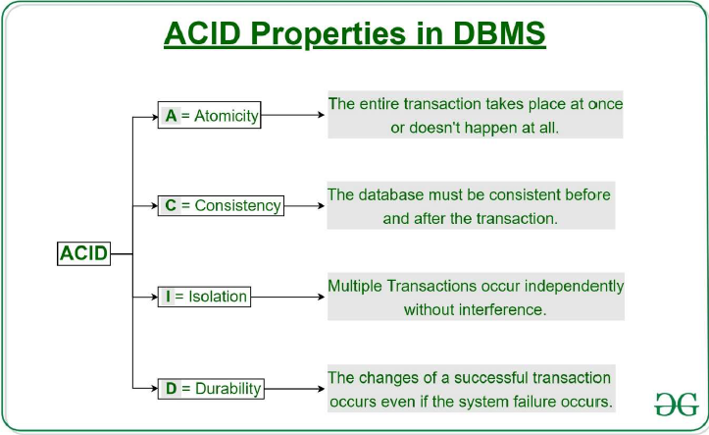

Slide 18
Atomicity:
Atomicity: The term atomicity defines that the data remains atomic. It means if any operation is performed on the data, either it should be performed or executed completely or should not be executed at all. It further means that the operation should not break in between or execute partially. In the case of executing operations on the transaction, the operation should be completely executed and not partially.
Consistency:
The word consistency means that the value should remain preserved always. In DBMS, the integrity of the data should be maintained, which means if a change in the database is made, it should remain preserved always. In the case of transactions, the integrity of the data is very essential so that the database remains consistent before and after the transaction. The data should always be correct.

Slide 19
Isolation:
The term 'isolation' means separation. In DBMS, Isolation is the property of a database where no data should affect the other one and may occur concurrently. In short, the operation on one database should begin when the operation on the first database gets complete. It means if two operations are being performed on two different databases, they may not affect the value of one another. In the case of transactions, when two or more transactions occur simultaneously, the consistency should remain maintained. Any changes that occur in any particular transaction will not be seen by other transactions until the change is not committed in the memory.
Durability:
Durability ensures the permanency of something. In DBMS, the term durability ensures that the data after the successful execution of the operation becomes permanent in the database. The durability of the data should be so perfect that even if the system fails or leads to a crash, the database still survives. However, if gets lost, it becomes the responsibility of the recovery manager for ensuring the durability of the database. For committing the values, the COMMIT command must be used every time we make changes.

Slide 20
Transaction and System Concepts
A transaction is an atomic unit of work that is either completed in its entirety or not done at all. A transaction passes through several states (Figure 21.4, similar to process states in operating systems).
Transaction states:
Active state (executing read, write operations)
Partially committed state (ended but waiting for system checks to determine success or failure)
Committed state (transaction succeeded)
Failed state (transaction failed, must be rolled back)
Terminated State (transaction leaves system)

Slide 22
Transaction and System Concepts (cont.)
DBMS Recovery Manager needs system to keep track of the following operations (in the system log file):
begin_transaction: Start of transaction execution.
read or write: Read or write operations on the database items that are executed as part of a transaction.
end_transaction: Specifies end of read and write transaction operations have ended. System may still have to check whether the changes (writes) introduced by transaction can be permanently applied to the database (commit transaction); or whether the transaction has to be rolled back (abort transaction) because it violates concurrency control or for some other reason.

Slide 23
Transaction and System Concepts (cont.)
Recovery manager keeps track of the following operations (cont.):
commit_transaction: Signals successful end of transaction; any changes (writes) executed by transaction can be safely committed to the database and will not be undone.
abort_transaction (or rollback): Signals transaction has ended unsuccessfully; any changes or effects that the transaction may have applied to the database must be undone.

Slide 24
Transaction and System Concepts (cont.)
System operations used during recovery
undo(X): Similar to rollback except that it applies to a single write operation rather than to a whole transaction.
redo(X): This specifies that a write operation of a committed transaction must be redone to ensure that it has been applied permanently to the database on disk.

Slide 25
Transaction and System Concepts (cont.)
The System Log File
Is an append-only file to keep track of all operations of all transactions in the order in which they occurred. This information is needed during recovery from failures
Log is kept on disk - not affected except for disk or catastrophic failure
As with other disk files, a log main memory buffer is kept for holding the records being appended until the whole buffer is appended to the end of the log file on disk
Log is periodically backed up to archival storage (tape) to guard against catastrophic failures

Slide 26
Transaction and System Concepts (cont.)
Types of records (entries) in log file:
[start_transaction,T]: Records that transaction T has started execution.
[write_item,T,X,old_value,new_value]: T has changed the value of item X from old_value to new_value.
[read_item,T,X]: T has read the value of item X (not needed in many cases).
[end_transaction,T]: T has ended execution
[commit,T]: T has completed successfully, and committed.
[abort,T]: T has been aborted.

Slide 27
Transaction and System Concepts (cont.)
The System Log (cont.):
protocols for recovery that avoid cascading rollbacks do not require that read operations be written to the system log; most recovery protocols fall in this category

Slide 28
Transaction and System Concepts (cont.)
Commit Point of a Transaction:
Definition: A transaction T reaches its commit point when all its operations that access the database have been executed successfully and the effect of all the transaction operations on the database has been recorded in the log file (on disk). The transaction is then said to be committed.

Slide 29
Transaction and System Concepts (cont.)
Commit Point of a Transaction (cont.):
Log file buffers: Like database files on disk, whole disk blocks must be read or written to main memory buffers.
For log file, the last disk block (or blocks) of the file will be in main memory buffers to easily append log entries at end of file.
Force writing the log buffer: before a transaction reaches its commit point, any main memory buffers of the log that have not been written to disk yet must be copied to disk.
Called force-writing the log buffers before committing a transaction.
Needed to ensure that any write operations by the transaction are recorded in the log file on disk before the transaction commits

Slide 30
Types of Failures
A DBMS is vulnerable to several kinds of failures and each of these failures needs to be managed differently. There are many reasons that can cause database failures such as network failure, system crash, natural disasters, carelessness, sabotage(corrupting the data intentionally), software errors, etc.

Slide 31
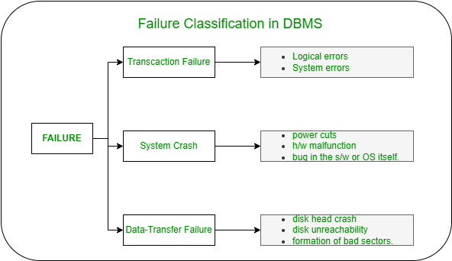
Failure Classification in DBMS

Slide 32
Transaction Failure:
If a transaction is not able to execute or it comes to a point from where the transaction becomes incapable of executing further then it is termed as a failure in a transaction.
Reason for a transaction failure in DBMS:
Logical error: A logical error occurs if a transaction is unable to execute because of some mistakes in the code or due to the presence of some internal faults.
System error: Where the termination of an active transaction is done by the database system itself due to some system issue or because the database management system is unable to proceed with the transaction. For example– The system ends an operating transaction if it reaches a deadlock condition or if there is an unavailability of resources.

Slide 33
System Crash:
A system crash usually occurs when there is some sort of hardware or software breakdown. Some other problems which are external to the system and cause the system to abruptly stop or eventually crash include failure of the transaction, operating system errors, power cuts, main memory crash, etc.
These types of failures are often termed soft failures and are responsible for the data losses in the volatile memory. It is assumed that a system crash does not have any effect on the data stored in the non-volatile storage and this is known as the fail-stop assumption.

Slide 34
Data-transfer Failure:
When a disk failure occurs amid data-transfer operation resulting in loss of content from disk storage then such failures are categorized as data-transfer failures. Some other reason for disk failures includes disk head crash, disk unreachability, formation of bad sectors, read-write errors on the disk, etc.
In order to quickly recover from a disk failure caused amid a data-transfer operation, the backup copy of the data stored on other tapes or disks can be used. Thus it’s a good practice to backup your data frequently.

Slide 35
Why recovery is needed
Causes of transaction failure:
1. A computer failure (system crash): A hardware or software error occurs during transaction execution. If the hardware crashes, the contents of the computer’s internal main memory may be lost.
2. A transaction or system error : Some operation in the transaction may cause it to fail, such as integer overflow or division by zero. Transaction failure may also occur because of erroneous parameter values or because of a logical programming error. In addition, the user may interrupt the transaction during its execution.

Slide 36
Why recovery is needed (cont.)
3. Local errors or exception conditions detected by the transaction:
- certain conditions necessitate cancellation of the transaction. For example, data for the transaction may not be found. A condition, such as insufficient account balance in a banking database, may cause a transaction, such as a fund withdrawal, to be canceled - a programmed abort causes the transaction to fail.
4. Concurrency control enforcement: The concurrency control method may decide to abort the transaction, to be restarted later, because it violates serializability or because several transactions are in a state of deadlock.

Slide 37
Why recovery is needed (cont.)
5. Disk failure: Some disk blocks may lose their data because of a read or write malfunction or because of a disk read/write head crash. This kind of failure and item 6 are more severe than items 1 through 4.
6. Physical problems and catastrophes: This refers to an endless list of problems that includes power or air-conditioning failure, fire, theft, sabotage, overwriting disks or tapes by mistake, and mounting of a wrong tape by the operator.

Slide 38
Thank You

